Slide 1
Introduction to Colab

Slide 2
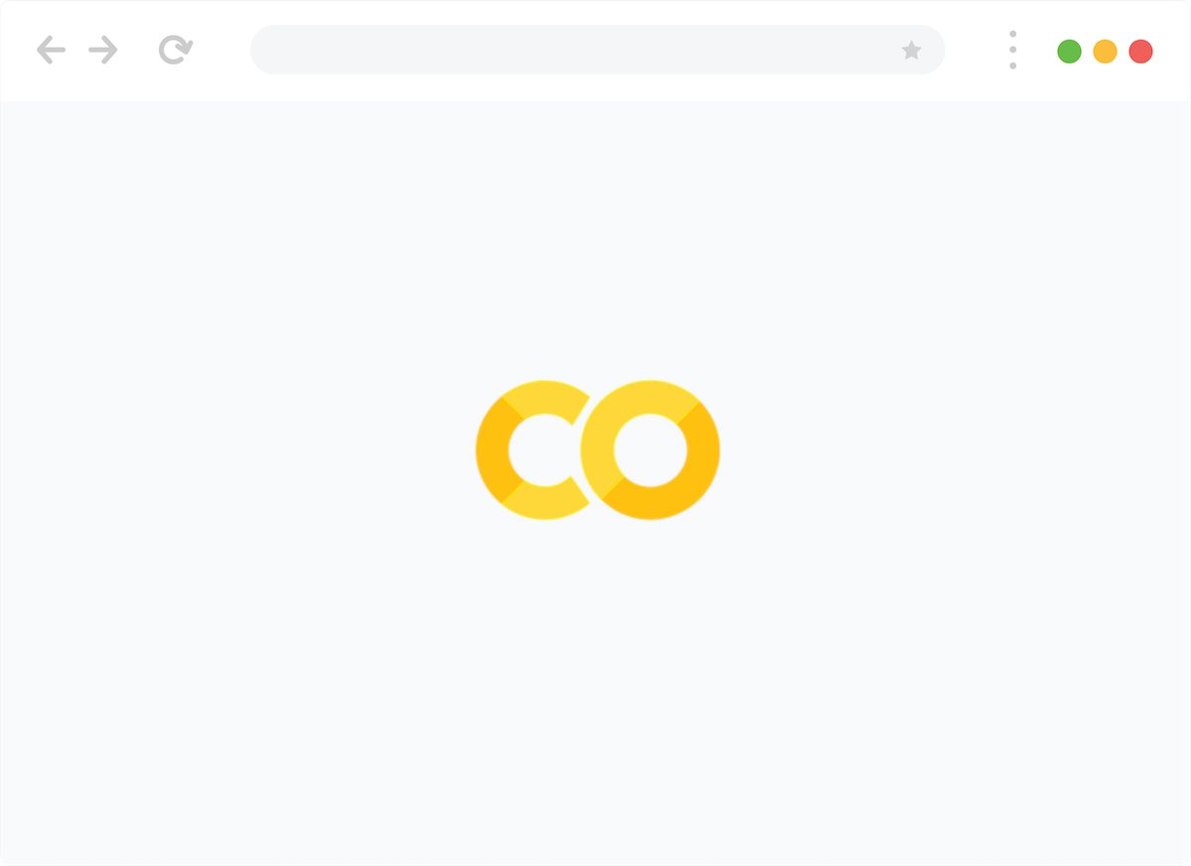
How will we use Colab in this course?
Code walkthroughs of algorithms and concepts
Notes:
https://pixabay.com/photos/code-programming-python-1084923/
We will use colab’s to visualize concepts like gradient descent
Note we by default train on the cloud to reduce the burden on your computer and to get access to GPU runtimes -- if you want to train it locally you can always download the collab as a local runtime

Slide 3
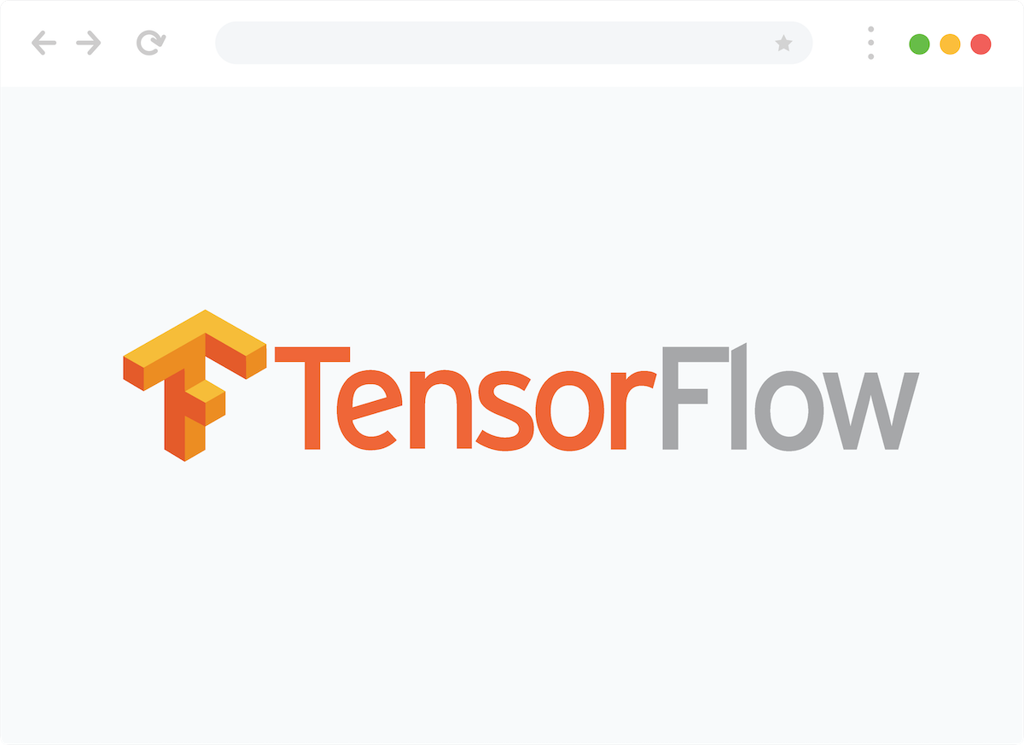
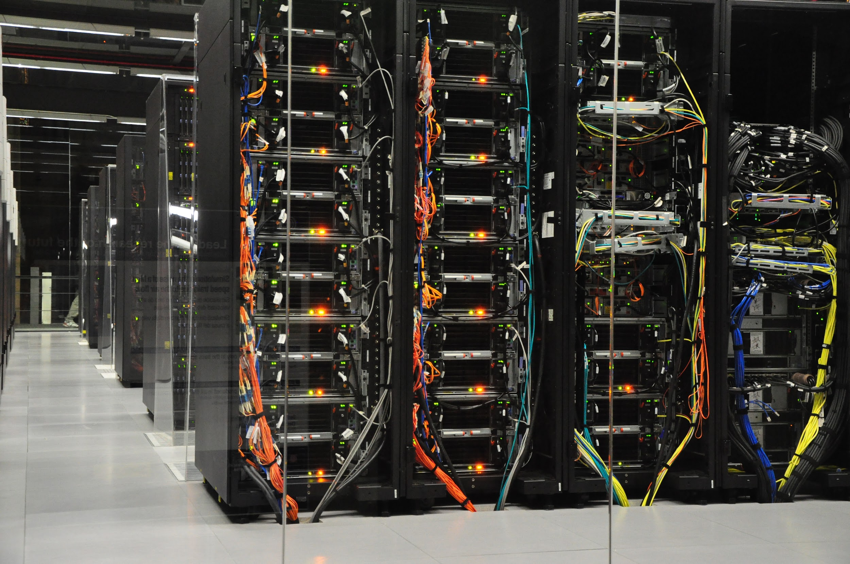
How will we use Colab in this course?
Code walkthroughs of algorithms and concepts
Training our Neural Networks (in the cloud)
Notes:
Note we by default train on the cloud to reduce the burden on your computer and to get access to GPU runtimes -- if you want to train it locally you can always download the collab as a local runtime
https://pixabay.com/photos/cyber-monday-pubg-nvidia-gaming-5268589/

Slide 4
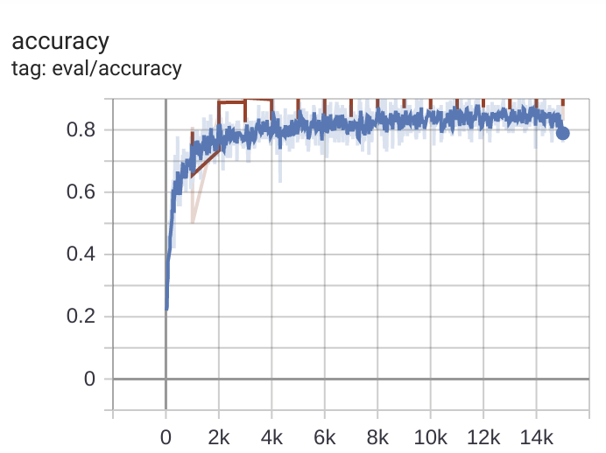
How will we use Colab in this course?
Code walkthroughs of algorithms and concepts
Training our Neural Networks (in the cloud)
Visualize the training characteristics of the model
Notes:
We will use colab’s to visualize concepts like gradient descent
Note we by default train on the cloud to reduce the burden on your computer and to get access to GPU runtimes -- if you want to train it locally you can always download the collab as a local runtime

Slide 5
Colab
Fullscreen of VJ

